Slide 1
CHILD LANGUAGE RESEARCH IN LATVIA: CONTEMPORARY PROBLEMS AND SOLUTIONS
VPP-LETONIKA-2022/1-0001
Prof., Dr. habil. philol. Dace Markus
Doc., Dr. paed. Agrita Tauriņa
Prof., Dr. psych. Tija Zīriņa
(Liepaja University)

Slide 2
INTRODUCTION
VPP-LETONIKA-2022/1-0001
Latvian is the only official language in Latvia and one of the symbols of an independent state
Latvia has historically developed as a country where both Latvians and ethnic minorities live
This set of circumstances determined the activity of our interdisciplinary research group - initially to conduct research on language acquisition in early childhood and further to use the data obtained in the study of language acquisition of preschool children, both Latvian-speaking children and children of minorities

Slide 3
INTRODUCTION
VPP-LETONIKA-2022/1-0001
Children of minorities have been a special research group, as different ways have been sought to help these children learn Latvian more successfully in order to ensure better success in school, which will be conducted exclusively in Latvian from 1 September 2023
Research is also being carried out with teachers who are involved in the children's language learning

Slide 4
RESEARCH ON LATVIAN CHILDREN LANGUAGE
VPP-LETONIKA-2022/1-0001
Research on Latvian children language have previously been related to the name of Professor Velta Rūķe-Draviņa (1917-2003). The Latvian-born professor performed the research of child language in Sweden, thus language development of Latvian children living in abroad was studied
For a long time these were the only studies of Latvian child’s language to base linguistic and pedagogical recommendations on

Slide 5
COOPERATION WITH NORWAY
VPP-LETONIKA-2022/1-0001
Our research team began regular studies of children's language in 2015 in the project «Latvian Language in Monolingual and Bilingual Acquisition: tools, theories and applications» funded by Norway Grants – Bilateral Research Cooperation with Latvia (NFI/R/2014/053)
4 partner institutions: University of Latvia, Institute of Mathematics and Computer Science; University of Latvia, Faculty of Humanities; Norway: UiT The Arctic University of Norway and University of Oslo
The project represents a systematic and comprehensive investigation of monolingual and bilingual acquisition of the Latvian language, unprecedented in theoretical and empirical scope

Slide 6
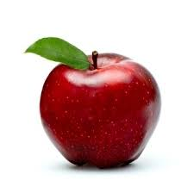
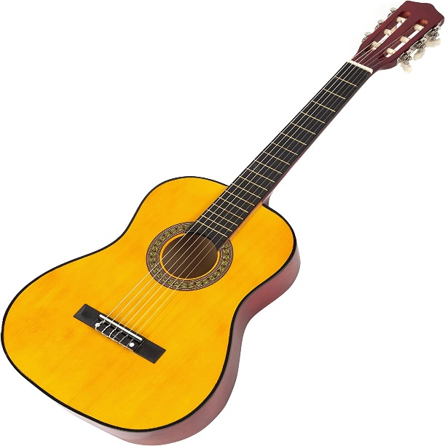
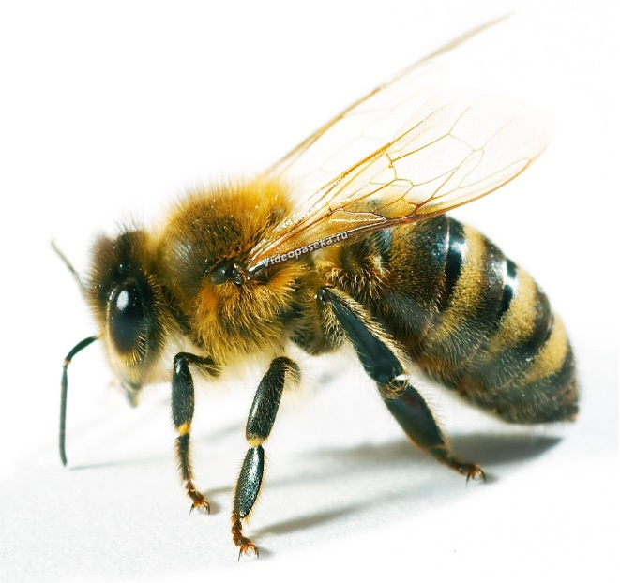
PRONUNCIATION TEST
VPP-LETONIKA-2022/1-0001
Our first task was to develop norm-referenced pronunciation accuracy tests for Latvian children ( 3-6 years) based on familiar images, children speech recordings were analysed
ĀBOLS BITE ĢITĀRA

Slide 7
PRONUNCIATION TEST
VPP-LETONIKA-2022/1-0001
Scoring sheet
 |  | TRANSCRIPTION |  | PRONUNCIATION | PRONUNCIATION
1. | BITE |  | B | Correct □ | Incorrect □
2. | ĀBOLS |  |  | Correct □ | Incorrect □
3. | GRAB |  |  | Correct □ | Incorrect □

Slide 8
PRONUNCIATION TEST
VPP-LETONIKA-2022/1-0001
All vowels and the specific Baltic diphthongs ie and o [uo] were covered, consonants were studied separately and in consonant compounds
Scientific articles were published, but these were only studies about children pronunciation

Slide 9
ASSESSMENT OF COMMUNICATIVE DEVELOPMENT
VPP-LETONIKA-2022/1-0001
The second task was to develop a norm-referenced Latvian adaptation of one of the most widely used parental report tools for the assessment of communicative development of infants and young children – the MacArthur-Bates Communicative Development Inventories ( CDI)
Two CDI forms were adapted: CDI Words and Gestures designed for use with children between 8 and 16 months of age, and CDI Words and Sentences designed for 16 to 36 months old children

Slide 10
NATIONAL RESEARCH PROGRAMME “Latvian language”
VPP-LETONIKA-2022/1-0001
In 2018, we decided to add pictures to the phoneme test, which encourage children to count, distinguish colours, sizes, shapes, answer questions, talk about the story in the picture, recognise letters and read simple words
Our research team is grateful to the National Research Programme “Latvian language” for the financial support

Slide 11
NATIONAL RESEARCH PROGRAMME “Latvian language”
VPP-LETONIKA-2022/1-0001
Sample picture for comparison of colours and figures

Slide 12
NATIONAL RESEARCH PROGRAMME “Latvian language”
VPP-LETONIKA-2022/1-0001
Between 2018 and 2021, we recorded children's speech in Kurzeme, Latgale and Riga, stimulated by the requirement that from 1 September 2019 schooling had to be at least 50% bilingual in Latvian and 50% bilingual in Russian

Slide 13
NATIONAL RESEARCH PROGRAMME “Latvian language”
VPP-LETONIKA-2022/1-0001
In the framework of the National Research Programme “Latvian language” (VPP-LETONIKA-2022/1-0001) our research group carried out recordings and analyzed the results of a picture-based language proficiency test in Latvian
We studied and evaluated the Latvian language skills of children in pre-school educational institutions in Kurzeme (2019 and 2020), Riga (2019 and 2020), and Latgale (2020) in accordance with the developed methodology

Slide 14
NATIONAL RESEARCH PROGRAMME “Latvian language”
VPP-LETONIKA-2022/1-0001
Were analyzed 25 speech recordings of Latvian children per year in each of the territories, 25 speech recordings of minority children in groups with Latvian on a daily basis and 25 speech recordings of minority children in groups with Russian on a daily basis. In Riga and Kurzeme, 150 recordings in 2019 were analyzed and in Kurzeme, Latgale, and Riga 225 recordings in 2020 were evaluated.
The total number of entries was 375

Slide 15
NATIONAL RESEARCH PROGRAMME “Latvian language”
VPP-LETONIKA-2022/1-0001
The following criteria were evaluated:
fluency of speech
pronunciation
vocabulary
grammar
literacy

Slide 16
CHALLENGES DURING COVID – 19 RESTRICTIONS
VPP-LETONIKA-2022/1-0001
In the survey 35 teachers took part, who work both in the Latvian-language general education programme and in the minority programme groups
The aim was to investigate the forms of teachers’ work in facilitating the learning of the Latvian language by pre-school age children during Covid-19 restrictions

Slide 17
CHALLENGES DURING COVID – 19 RESTRICTIONS
VPP-LETONIKA-2022/1-0001

Slide 18
CHALLENGES DURING COVID – 19 RESTRICTIONS
VPP-LETONIKA-2022/1-0001
Stress the role of the family and the environment in language learning
During the home quarantine the children forgot what they had learnt, because the skills were not consolidated through use
Teachers in pre-school education institutions rated the current school readiness of children as partial, and the performance of the group attended by minority ethnic children only was rated as unsatisfactory

Slide 19
CONCLUSION
VPP-LETONIKA-2022/1-0001
The analysis of language recordings shows that regardless of the nationality the Latvian language skills of those children who attended pre-school education groups with class activities conducted in Latvian on a daily basis are good
The Latvian language skills of minority children who attend pre-school education groups with a dominant Russian language on a daily basis are still insufficient. This conclusion does not depend on the region in which the children live. These children are Russian monolinguals and this does not facilitate their communication outside the family and community

Slide 20
CONCLUSION
VPP-LETONIKA-2022/1-0001
Pre-school minority children who attend groups with a dominant Russian language on a daily basis have limited vocabulary, underdeveloped dialogue, impaired speech, which is intensified by very minimal grammar knowledge
The results of the research clearly show that pre-school age minority children are able to imitate another language well because in all the studied regions the Latvian language pronunciation indicators are the best for the minority children. Insufficient knowledge of the Latvian language, in general, can be explained by the insufficient use of Latvian in everyday life

Slide 21
CONCLUSION
VPP-LETONIKA-2022/1-0001
In order for minority children of pre-school age to successfully learn Latvian in accordance with the legislation, it is not enough to have only a few Latvian language lessons a week, but it is necessary to create a real bilingual language usage environment that may include communication, games, visual aids, etc. in daily pre-school education groups
The results and recommendations regulary? have been presented to the specialists responsible for pre-school education in the Ministry of Education and Science

Slide 22
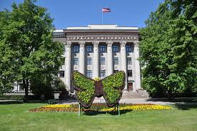
Thank you for your attention !
VPP-LETONIKA-2022/1-0001

